Slide 1
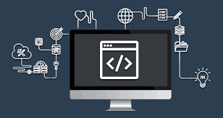
VIDEO CONFERENCING BACKEND DEVELOPMENT
TEAM MEMBERS
PRIYA S
GOMATHI H
SOWMIYA S
ABINESH M

Slide 2
INTRODUCTION
Video conferencing is a live video-based meeting between two or more people in different locations using video-enabled devices. Video conferencing allows multiple people to meet and collaborate face to face long distance by transmitting audio, video, text and presentations in real time through the internet. They use a computer connection, audio, and video to connect. Video conferencing can be used for team meetings, webinars, product demos, job interviews, and more. The main purpose of video conferencing is to help people connect, regardless of where they're located.

Slide 3
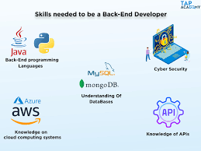

Slide 4
DYNAMIC FRONTEND
Integrate the APIs to frontend to ensure the dynamic feature of website
Point base api to the severs base url
Design api calls for each element
Handle errors in the output
Render output of apis to different low level components
Secure content of post apis

Slide 5
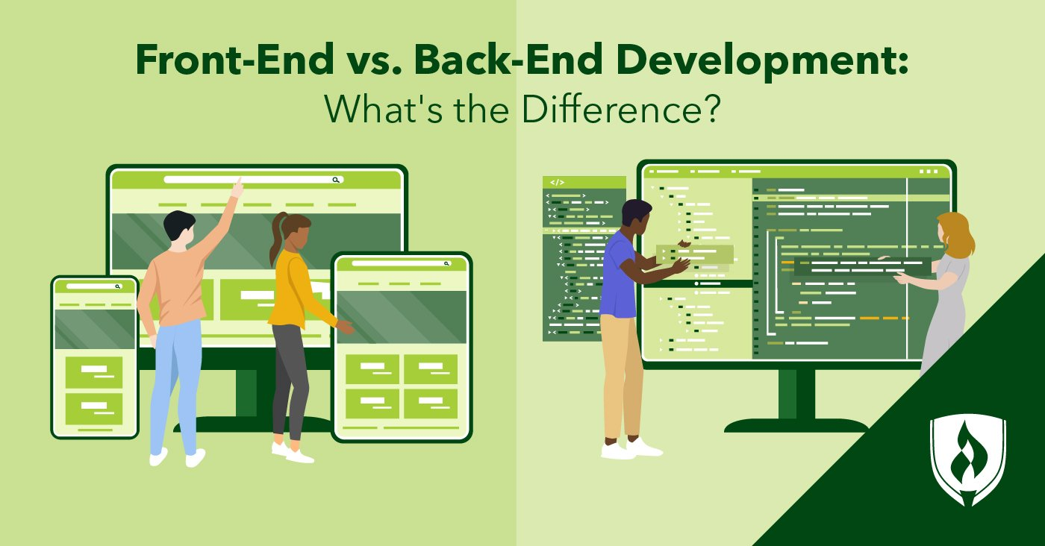

Slide 6
STEP WISE DESCRIPTION
A network for data transfer, such as wired/wireless local area network, wide area network, cellular wireless and residential broadband.
Two or more video cameras or webcams that provide video input.
Two or more microphones -- either an external microphone or one built into the accessing device.
A computer screen, monitor, TV or projector that can broadcast video output.
Headphones, laptop speakers or external speakers that can be used for audio output.
Codecs, which can be hardware- or software-based, to reduce bandwidth by compressing and decompressing AV data.

Slide 7
BACKEND
Back-end development involves everything that exists in the server. This includes everything from data modeling and storage to security concerns. Back-end development makes the front-end of a website possible by building and maintaining the systems that makes user interaction possible
the portion of the website you don't see. It's responsible for storing and organizing data, and ensuring everything on the client-side actuall works. The backend communicates with the frontend, sending and receiving information to be displayed as a web page

Slide 8
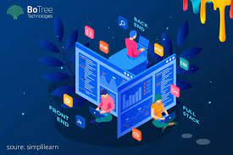
Thank you

